Slide 1
Solving CTF By Using Python
Name 迪瓦斯
4070E092

Slide 2
AGENDA

Slide 3
Google Colab
Colaboratory, or "Colab" for short, allows you to write and execute Python in your browser, with
Zero configuration required
Free access to GPUs
Easy sharing
Whether you're a student, a data scientist or an AI researcher, Colab can make your work easier. Watch Introduction to Colab to learn more, or just get started below

Slide 4
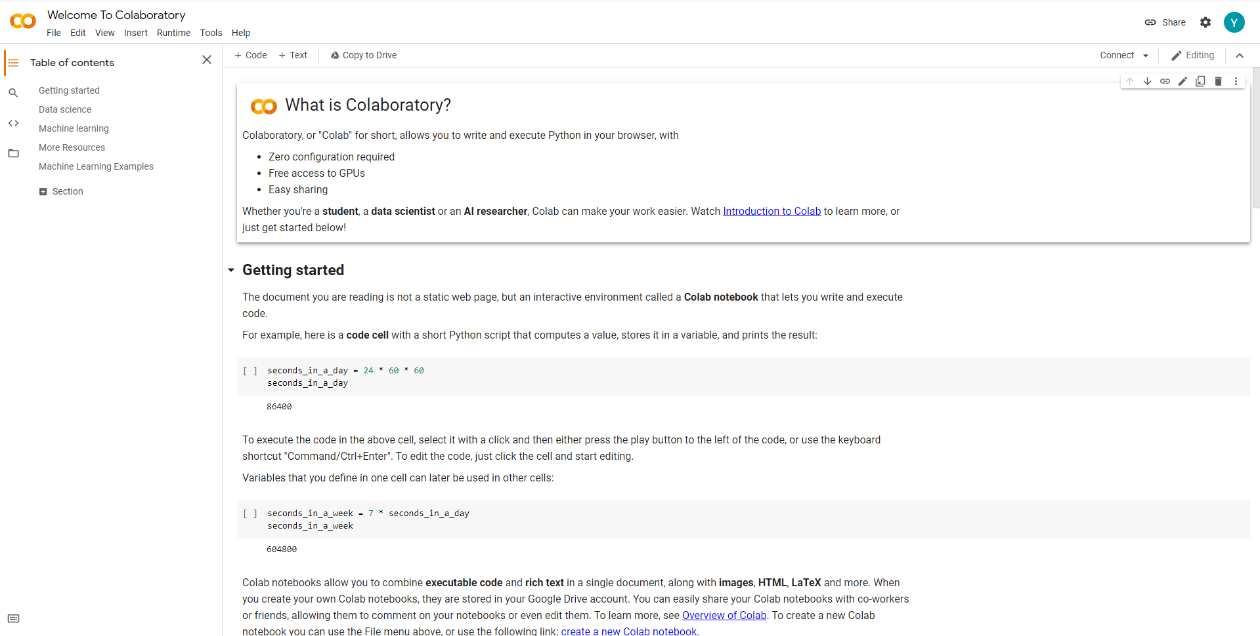

Slide 5
